Slide 1
Artificial Intelligence
CS-451
Instructor : Syed Musharaf Ali

Slide 2
Logistic Regression
Logistic regression is a statistical model that in its basic form uses a logistic (sigmoid) function to model a binary dependent variable(class), for classification
Notes:
Cognitve : process of knowing, learning

Slide 3
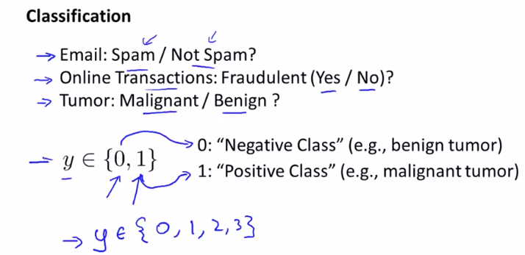
Classification
Binary classification
Multiclass classification
Notes:
Cognitve : process of knowing, learning

Slide 4
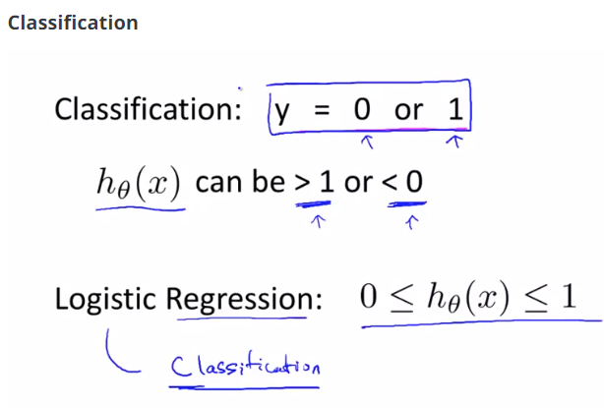
Notes:
Cognitve : process of knowing, learning

Slide 5
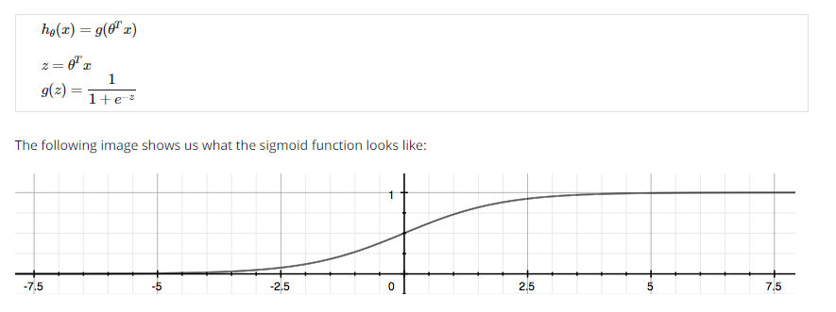
"Sigmoid Function," also called the "Logistic Function
Notes:
Cognitve : process of knowing, learning

Slide 6
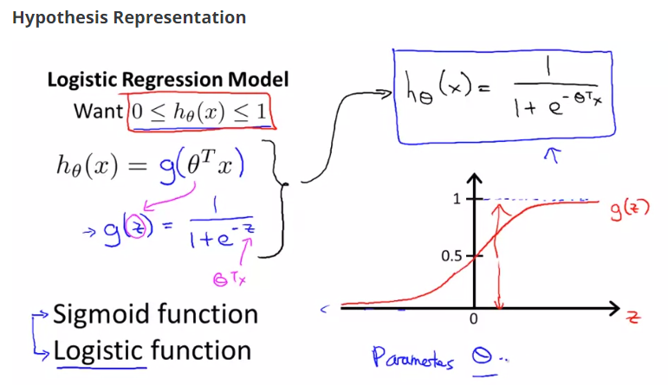
"Sigmoid Function," also called the "Logistic Function
Notes:
Cognitve : process of knowing, learning

Slide 7
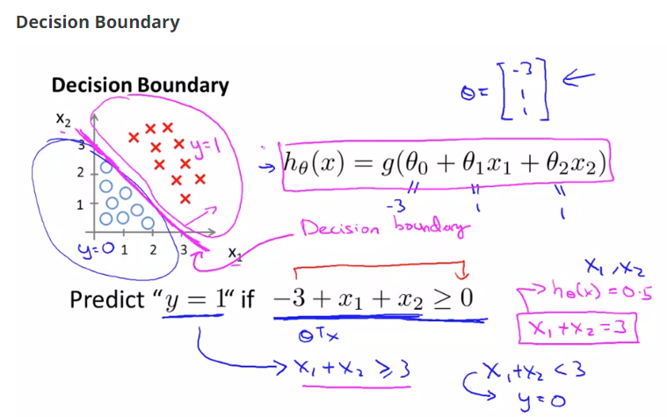
The decision boundary is the line that separates the area where y = 0 and where y = 1.
Notes:
Cognitve : process of knowing, learning

Slide 8
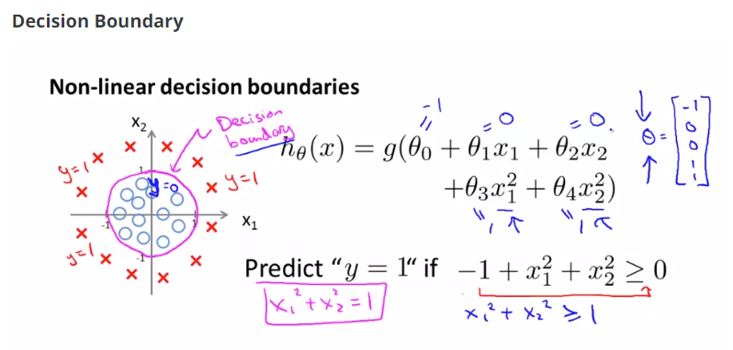
Notes:
Cognitve : process of knowing, learning

Slide 9
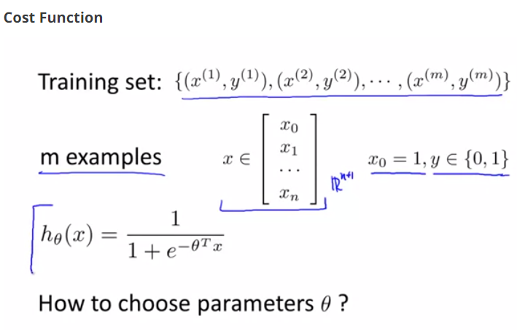
Cost Function
Notes:
Cognitve : process of knowing, learning

Slide 10

Cost Function
We cannot use the same cost function that we use for linear regression because the Logistic Function will cause the output to be wavy, causing many local optima. In other words, it will not be a convex function.
Instead, our cost function for logistic regression looks like:
Notes:
Cognitve : process of knowing, learning

Slide 11
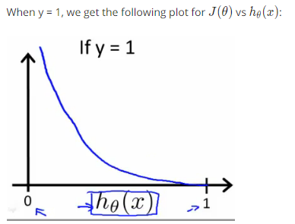
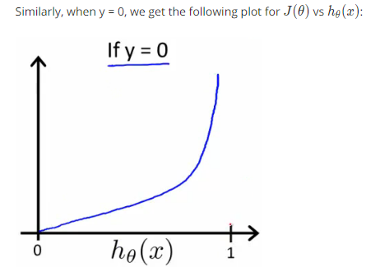
Cost Function
Notes:
Cognitve : process of knowing, learning

Slide 12

Cost Function
If our correct answer 'y' is 0, then the cost function will be 0 if our hypothesis function also outputs 0.
If our hypothesis approaches 1, then the cost function will approach infinity.
If our correct answer 'y' is 1, then the cost function will be 0 if our hypothesis function outputs 1.
If our hypothesis approaches 0, then the cost function will approach infinity.
Notes:
Cognitve : process of knowing, learning

Slide 13

Simplified Cost Function and Gradient Descent
Notes:
Cognitve : process of knowing, learning

Slide 14

Gradient Descent
Notes:
Cognitve : process of knowing, learning

Slide 15
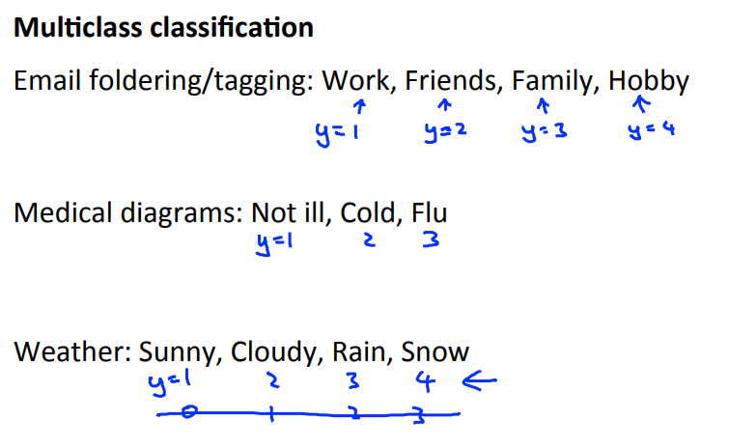
Notes:
Cognitve : process of knowing, learning

Slide 16
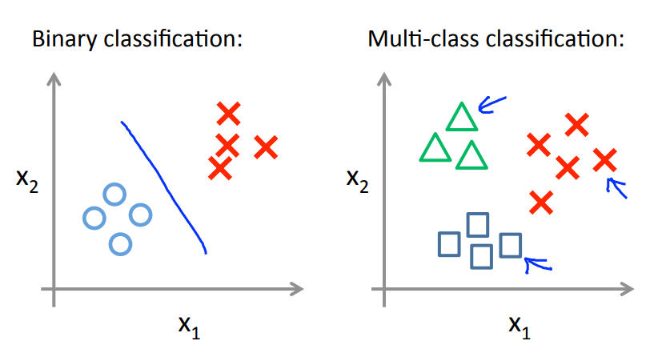
Notes:
Cognitve : process of knowing, learning

Slide 17
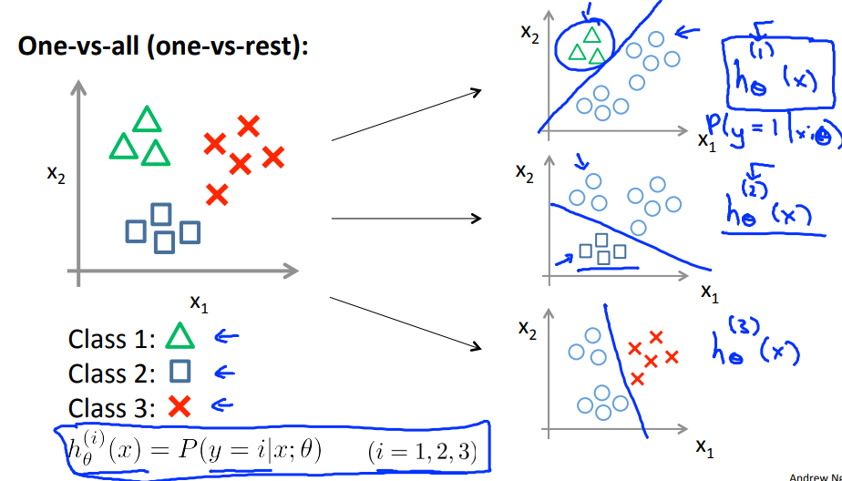
Notes:
Cognitve : process of knowing, learning

Slide 18
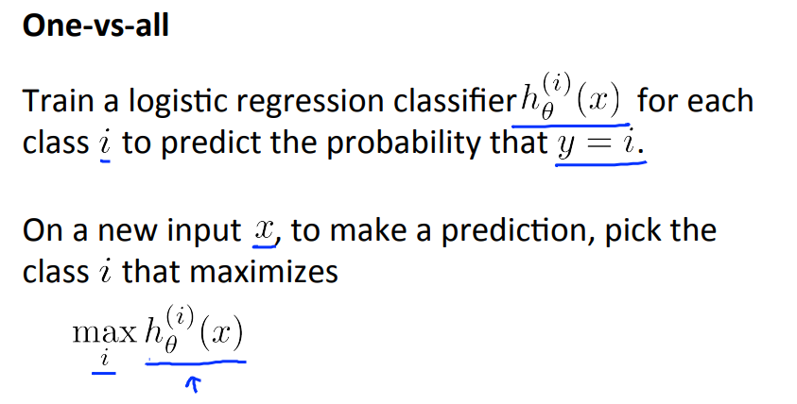
Notes:
Cognitve : process of knowing, learning

